Slide 1

BULLyING and its impacts
Muhammad Shoaib
Zalaid Butt
Um e Abeeha

Slide 2
Survey Questionnaire
Impacts
Changes In Behavior?
Affect On Academic?
Physical Impact?
Awareness
Reasons of not reporting?
Witness?
Comfort Level?
Personal Information
Age?
Gender?
Bullying Experiences
Personal Experience?
Type of Bullying?
Affects On Mental Health?
Prevention
Additional Measures?
Seeking Support?
Effectiveness Of Institutions?

Slide 3
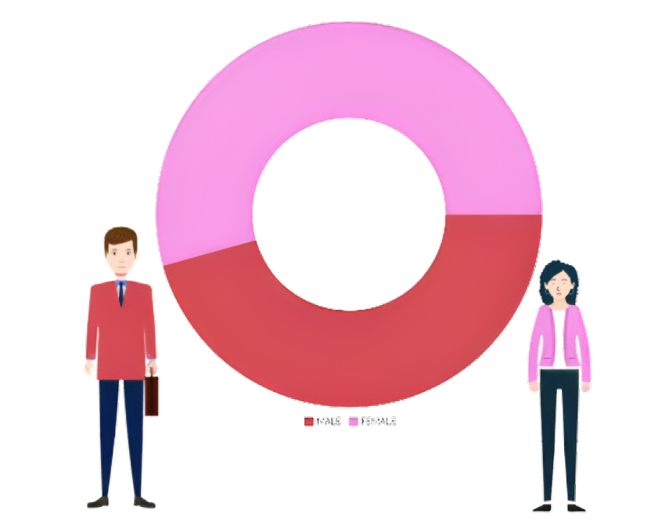
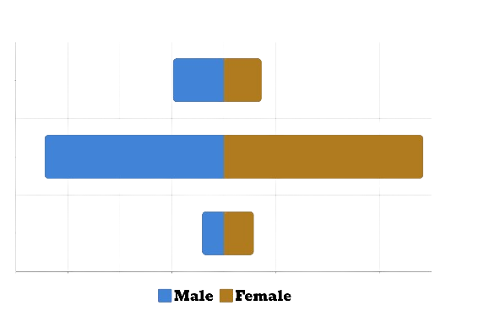
Demogaraphics
51.5%
Under 18
9.8%
7.3%
34.5%
18-22
38.4%
22 Above
48.5%
4.2%
5.8%

Slide 4
H0 : P1 = P2
Assessment of Questions
Q1: Perception In Bullying Experiences
Method : Hypothesis Test-Proportion
P1 = Percentage of males experiencing bullying
P2 = Percentage of females experiencing bullying
H1 : P1 < P2 (one tail test)
Result:
Confidence level = 95%, n1 = 64, n2 = 76
Z (cal) =0.48284, Z(tab) = -1.959
Conclusion:
Failed to accept H0, because as shown in our analysis females are being bullied more than males

Slide 5
H0: Average of comfort is μ = 4
Assessment of Questions
Q2: Bullying talk comfort: Neutral (mean: 3)
Method : Hypothesis Test-t-distribution
μ= Comfort discussing bullying averages at 4.
H1: Average of comfort is μ < 4
Result:
Confidence level = 95%, n = 152,
(t-score): 1.9761
95% Confidence Interval: (2.5521,2.9843)
Conclusion:
Failed to accept H0, because as shown in our analysis that comfort level is less than 4

Slide 6
H0 : Impact on mental health = 3
Assessment of Questions
Q3: Effects on mental health mean > 3
Method: Hypothesis Test-t-distribution
μ = Average of bullying impact on mental health is at 3
H1 : Impact on mental health > 3
Result:
Confidence level = 90%, n = 152
(t-score): 1.6551
95% Confidence Interval: 3.708 ± 0.1893
Conclusion
Failed to accept H0, because as shown in our analysis that effect of mental health is greater than 3

Slide 7
H0 : Institutional effectiveness against bullying = 3
Assessment of Questions
Q4: Institutional effectiveness against bullying
Method : Hypothesis Test-t-distribution
μ = Institution’s bullying prevention is at 2
H1 : Institutional effectiveness against bullying < 3
Result:
Confidence level = 95%, n = 152,
(t-score): 1.9761
95% Confidence Interval: 2.4132 ± 0.2244
Conclusion:
Failed to accept H0, because as shown in our analysis that Institutional effectiveness against bullying < 3

Slide 8
H0 : P1 - P2 = 0.50
Assessment of Questions
Q5: Exploring Bullying Different Encounters
Method : Hypothesis Test-Proportion
P1 = Percentage of People experiencing Verbal bullying
P2 = Percentage of People experiencing Physical bullying
H1 : P1 - P2 < 0.50 (one tail test)
Result:
Confidence level = 90%, n1 = 110, n2 = 90
Z(tab) = 1.64
Confidence Interval = 0.2756 ± 0.21
Conclusion:
Failed to accept H0, because as shown in our analysis that the Confidence Interval of verbal and physical bullied people is less than 0.5

Slide 9
H0 : P0 = 0.60
Assessment of Questions
Q6: Factors Influencing Non-Reporting Bullying
Method : Hypothesis Test-Proportion
P0 = Percentage of Lack of trust in authorities
H1 : P0 ≠ 0.60 (two tail test)
Result:
Confidence level = 95%, n=152, P-hat=0.58
Z(cal) = 0.0 , Z(tab) = 1.96
Z(cal) < -Z(tab) or Z(cal) >Z(tab)
Conclusion:
Failed to reject H0, because as shown in our analysis that the Percentage Of Lack of Trust In Authorities is equal to 0.60

Slide 10
H0 : P0 = 0.60
Assessment of Questions
Q7: Factors Influencing Non-Reporting Bullying
Method : Hypothesis Test-Proportion
P0 = Percentage of Lack of trust in authorities
H1 : P0 ≠ 0.60 (two tail test)
Result:
Confidence level = 95%, n=152, P-hat=0.58
Z(cal) = 0.0 , Z(tab) = 1.96
Z(cal) < -Z(tab) or Z(cal) >Z(tab)
Conclusion:
Failed to reject H0, because as shown in our analysis that the Percentage Of Lack of Trust In Authorities is equal to 0.60

Slide 12
H0 : P1 - P2 = 0.30
Assessment of Questions
Q5: Exploring Bullying Different Encounters
Method : Hypothesis Test-Proportion
P1 = Percentage of People experiencing Social bullying
P2 = Percentage of People experiencing Cyberbullying
H1 : P1 - P2 < 0.30 (one tail test)
Result:
Confidence level = 95%, n1 = 120, n2 = 105
Z(tab) = 1.96
Confidence Interval = 0.193 ± 0.08
Conclusion:
Failed to accept H0, because as shown in our analysis that the Confidence Interval of Social and Cyberbullied people is less than 0.3

